Slide 1
TPO Weathering
By: Zebonie Sukle

Slide 2
OVERVIEW OF PRESENTATION
Introduction on Product Standards
Single Ply Product Standards Overview
Focus on Accelerated Aging
Predicting What is Next – Case Study
Taking TPO to 275ºF
Risks and Benefits
Summary

Slide 3




INTRODUCTION
Importance of Product Standards
  Establish Baseline Requirements for durability/ performance
  Provides Assurance
  Minimizes material failures
Examples of Product Standards
Miami Dade
Notes:
Important role Product Standards Play:
- Establish baseline requirements for functional and durability requirements of membranes
To provide building designers assurance in long-term durability of materials that are specified.
The Risk – Unintended Consequences
Do not represent field related issues – we will get into this a little bit more but historically Product standards have been changed as a result of field failures. We have not done a very good job of developing products that are successful the first time out of the gate.
Developing Products that meet the test requirements artificially limits us in looking at only one aspect of product performance instead of taking a broader holistic look at how products need to perform.

Slide 4
INTRODUCTION
Risk of Product Standards
  Do not represent field related issues
  Developing products that meet the test requirements
  Unintended Consequences
Notes:
Do not represent field related issues – Were

Slide 5
PRODUCT STANDARDS FOR MEMBRANES
Membrane durability
Typically quantified by physical property test methods
Accelerated physical property testing
  Moisture
  Temperature
  UV
  Atmospheric Pollutants
Test of Time
  Historical performance
  Impractical for the rapid growth of new technologies
Notes:
Looking at compression, impact, elongation, tear, etc.
All in an attempt to accelerated the degradation mechanisms experienced in-service
But ultimately the durability of roofing membranes is measured in the “Test of Time”. So if you want to verify that a roof will resist hail impact for 20 years, you will need to evaluated hail impact on a 20 year old roof.

Slide 6
ASTM PHYSICAL PROPERTY TESTING
TPO - ASTM D6878
  7.1, 7.2, 7.4, 7.5, 7.6, 7.12 reference ASTM D751 (dimensions, thickness, tensiles, tears)
  7.3 references ASTM D7635/7635 M (thickness over scrim)
  7.7 references ASTM D2137 (brittleness point)
  7.8 references ASTM D1149 (ozone resistance)
EPDM - ASTM D4637/4637M
  8.1, 8.2, 8.4, 8.9, 8.12 references ASTM D751 (dimensions, thickness, tensiles, tears)
  8.3 references ASTM D7635/7635 M (thickness over scrim)
  8.5, 8.8, 8.10 references ASTM D412 (NR tensiles/tensile set)
  8.6 references ASTM D5635 (dynamic puncture resistance)
  8.7 references ASTM D5602 (static puncture resistance)
  8.11 references ASTM D624 (NR tear)
  8.13 references ASTM D D2137 (brittleness point)
  8.14 references ASTM D1149 (ozone resistance)
  8.17 references ASTM D816 (factory seam strength)
  8.18 references ASTM D413 (fabric adhesion)
PVC - ASTM D4434/4434M
  8.2 references ASTM D638/D751 (Thickness)
  8.3, 8.4, 8.5, 8.8, references ASTM D (tensile, tear and seam strength)
  8.7 references ASTM D1004 (type 2 tear)
  8.9 references ASTM D2136 (low temp bend)
  8.13 references ASTM D5602 (static puncture resistance)
  8.14 references ASTM D5635 (dynamic puncture resistance)

Slide 7
ASTM ACCELERATED TESTING
TPO – D6878
  7.9 references ASTM D573 (heat aging)
  7.10 references ASTM D1204 (linear dimensional change)
  7.11 references ASTM D471 (water absorption)
  7.13 references ASTM G155 and G151 (weather resistance)
EPDM - D4637/4637M
  8.19, 8.20 references ASTM G155 and G151 and D518 (weather resistance)
  8.15 references ASTM D573 (heat aging)
  8.15.5 references ASTM D1204 (linear dimensional change)
  8.16 references ASTM D471 (water absorption)
PVC – D4434/4434M
  8.10 references ASTM G151, G154 & G155 (weather resistance)
  8.11 references ASTM D1204 (linear dimensional change
  8.12 references ASTM D570 (water absorption)
  8.6 references ASTM D3045 (heat aging)

Slide 8
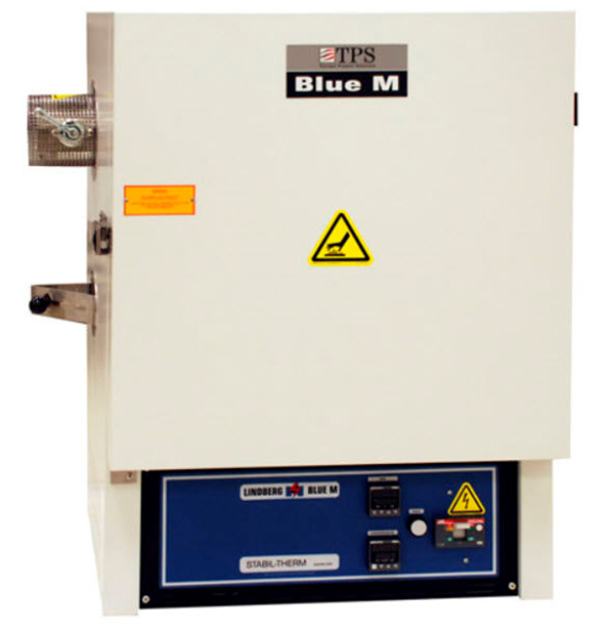

HOW ROOFING DOES ACCERATED HEAT
Heat aging for roofing membranes typically uses laboratory ovens.
  -Critical Requirements:
  - Oven size
  - Oven controls requirements
  - Air flow requirements

Slide 9
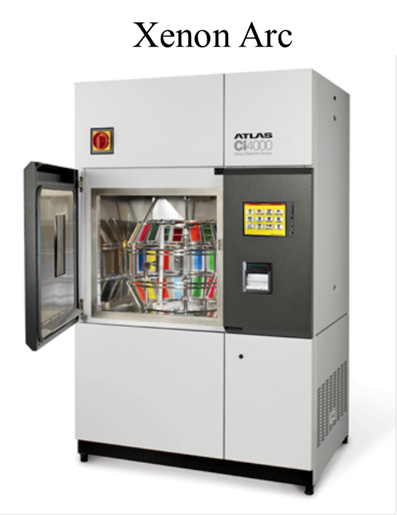
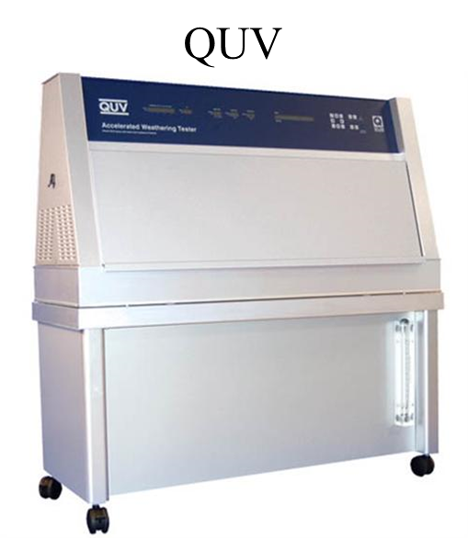
HOW ROOFING DOES ACCELERATED UV
Sunlight or UV aging in the roofing industry is typically done with either a QUV or a Xenon Arc Weatherometer.
  Critical Requirements
    UV Spectrum
    Moisture Cycle
    Etc.

Slide 10
TEST OF TIME

Slide 11
FOCUS IS ON ACCELERATED AGING
Definition:
Accelerated aging is testing that uses aggravated conditions of heat, oxygen, sunlight, vibration, etc. to speed up the normal aging processes of items. It is used to help determine the long-term effects of expected levels of stress within a shorter time, usually in a laboratory by controlled standard test methods.

Slide 12
KEY REQUIREMENT
“…the aging conditions are chosen in order to reduce the time required to achieve a desired material end-state, but without changing the damage mechanisms identified for the operational environment. (Italics added.)”
(Gates & Grayson, 1999.)
Notes:
Title of paper was “On the use of accelerated aging methods for screening high temperature polymeric composite materials
Gates was a research scientist with NASA Langley Research Center and Grayson was an Assistant Director, for the Center for Biomedical and Bioorganic Mass Spectrometry

Slide 13


HISTORY ON ACCELERATED AGING METHODS
1960 1980 1990 2000 2015
EPDM roofing membranes were commercialized in the US.
ASTM changed linear dimensional requirement for EPDM as a result of field performance issues
PVC membranes began using scrim reinforcement and higher molecular weight and solid plasticizers to address field performance issues
TPO entered the roofing market.
2006 TPO ASTM adjusted UV requirements higher as a result of field performance issues.
2011 TPO ASTM adjusted Thermal requirements higher
In the 1970, PVC membranes began to be used in the US after having been widely used in Europe since the 1960.
2003 ASTM Adopted D6878 for TPO
2002 ASTM established D6754 for PVC sheets with a minimum of 50% KEE polymer by weight of the polymer content of the sheet.

Slide 14
ACCELERATED AGING STANDARDS
For All Single Ply Roofing Membranes
Roofing Membrane | ASTM Reference Standard | Required Ultraviolet Aging [kJ(m²·nm)] | Required Heat Aging
 |  |  | Temperature (ºF) | Duration (Days)
EPDM (black) | D 4637 | 10,080* | 240 | 28
EPDM (white) | D4637 | 2,520 | 240 | 28
PVC | D 4434 | 6,480 ** | 176 | 56
TPO (2003) | D6878 | 5,040 | 240 | 28
TPO (Current) | D 6878 | 10,080 | 240 | 224
* ASTM has approved a ballet proposal to increase EPDM to 10,080 kJ(m²·nm) in 2015. it was previously 5,040 kJ(m²·nm).
** UV requirements for a Xenon Arc, PVC ASTM allows for both Xenon Arc and QUV (12,240 kJ(m²·nm) ).

Slide 15
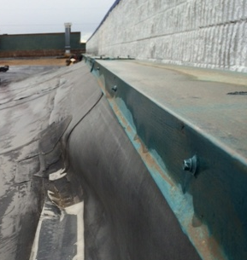
EPDM
EPDM
Linear Dimensional Failures
Industry Actions
Reduced Linear Dimensional Product Standard to 1%.
Changed termination of membrane to parapet.
Accelerated Product
Standards
Remained the same from 1980 to 2014. UV was updated in 2015.
Notes:
Few changes have been made to the overall ASTM standard since the dimensional stability shrinkage requirement was reduced in the early 1980s to address in-service membrane shrinking. The criteria of 5,040 kJ(m²·nm) for ultraviolet aging and 28 days of heat aging at 240ºF appear relatively low.

Slide 16
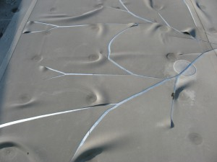
PVC
PVC
Shattering PVC
Industry Actions
Reinforced PVC membrane
High molecular weight and solid plasticizers
Accelerated Product
Standards
Remained the same 1980
Notes:
PVC has been used for as long as EPDM, but there were still early failures, resolved by adding reinforcements and using high molecular weight and solid plasticizers.

Slide 17
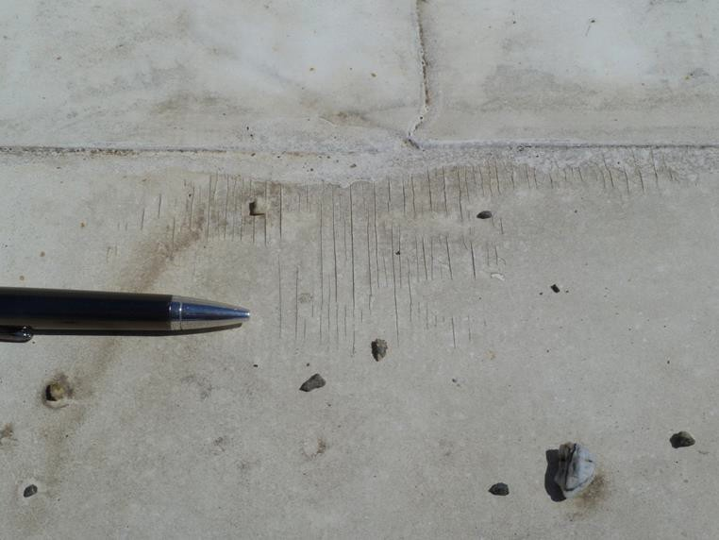
TPO
TPO
Thermal Stability, mid-1990s
UV Stability
Solar impact
Industry Actions
- White TPO
- Magnesium Hydroxide replace Brominated Fire retardants
- Improved Stabilization
Accelerated Product
Standards
Changes made as recent at 2011

Slide 18
TPO Aging – UV Weathering & the ASTM
2003 TPO ASTM D6878 Adopted
UV Xenon Arc Minimum: 5040 kJ/m²-nm
60% Retention of Physical Properties
Visual Inspection at 7X over a Mandrel for cracks
2006 TPO ASTM D6878 Updated
UV Xenon Arc Minimum: 10,080 kJ/m²-nm
60% Retention of Physical Properties
Visual Inspection at 7X over a Mandrel for cracks
2008 TPO ASTM D6878 Updated
UV Xenon Arc Minimum: 10,080 kJ/m²-nm
60% Retention of Physical Properties
Visual Inspection at 7X over a Mandrel for cracks

Slide 19
SINGLE PLY UV REQUREMENTS
UV Performance
EPDM 5,040 kJ(m²·nm)
TWICE that of EPDM
More than 1.5X that of PVC
PVC* 6,480 kJ(m²·nm)
TPO 10,080 kJ(m²·nm)
* The ASTM for PVC allows for the use of both the Xenon Arc and QUV for UV testing. Comparison here was done using Xenon Arc so that direct comparison could be made. QUV testing would result in 12,240 kJ(m²·nm).

Slide 20
CURRENT TPO vs. PRE-2008 TPO
Question: Were the formulations stabilized enough for UV?
Started in 2009.
Started in 2007.
Xenon Arc weathering tests for 45 mil membrane.
Crack investigation at 40X magnification.
Market samples (blinded).
Notes:
Although the Product Standard for TPO membranes for UV stability was doubled in 2006, most membrane manufactures have increased their stabilization well above new requirement of 10080 kJ/m2.

Slide 21
TPO Heat Aging & ASTM
2003 TPO ASTM D6878 Adopted
Oven Aging (D573) at 240 F (116 C) for 28 days
90% Retention of Breaking strength and elongation
60% Retention of Tearing Strength
2011 TPO ASTM D6878 Updated
Oven Aging (D573) at 240 F (116 C) for 224 days
90% Retention of Breaking strength and elongation
60% Retention of Tearing Strength
2012 -2015 TPO ASTM D6878 higher temperature
Proposed revisions are being review.
Mandrel wrap at 7x magnification for cracks.

Slide 22
SINGLE PLY THERMAL PERFORMANCE
Thermal Performance
EPDM 28 days @ 240ºF
8 times longer than EPDM
PVC 56 days @ 176ºF
50x more heat exposure than PVC
TPO 224 days @ 240ºF

Slide 23
ADDRESSING THE ISSUES
Changes to the product standards have been made as a reaction to field failures
  EPDM
    Membrane Shrinkage
  PVC
    Shattering Membrane
  TPO
    Early 2-3 year failures due to heat exposure of black TPOs
    5-year failures associated with UV and flame-retardants have been eliminated
    7-year failures associated with combined heat and UV have been eliminated
    WHAT IS NEXT?

Slide 24
PREDICTING WHAT IS NEXT?
Increasing the Accelerated Aging Temperature to 275ºF
Scientific Accelerated Aging verses “Torture Test”
Example of “Torture Test”
  BP Lubricants USA., the maker of Castrol EDGE oil, comparative advertising campaign.
Notes:
In an attempt to predict the next failure, recent testing efforts have been focused around increasing the accelerated heat aging requirements.
Scientific Accelerated Aging ensure that the aging conditions chosen reduce the time required to achieve a desired material end-state, but do not change or damage mechanisms identified for the operational environment.
Torture test:
Advertising campaign pitted BPs product against Exxon Mobil’s Mobil 1.
The advertising deplicted two cars on a dynamometer running at 75 miles per hour on a 7% grade fully loaded at 1,600 lbs. Which is equivalent to driving a fully loaded car continuously up one of the steepest mountain passes suitable for a vehicle for a distance of 9,000 miles.
They pushed the cars for 5 straight days and on the 5th day the Mobil 1 engine failed and the Castrol EDGE engine continued to run.
ExxonMobil filed a complaint and although they did not dispute the results argued that this test represents a “torture test”.
The National Advertising Division opinion was that the test conditions did not represent conditions to which consumers would ever subject a car’s engine too. Essentially, just because the oil worked well in these tortuous conditions, it not mean that the oil would last longer in normal service conditions.
The NAD’s conclusion is similar to Gate’s and Grayson’s caution about testing that changes the damage mechanisms identified for the real-world environment.
The caution for roofing designers or specifiers and the industry is to beware of accelerating testing methods to a point so far outside the typical application range in which test outcomes may not be testing real world performance conditions.

Slide 25
TORTURE TEST BACKGROUND
Case Study
Advertising campaign pitted BPs product against Exxon Mobil’s Mobil 1.
The advertising depicted two cars on a dynamometer running at 75 miles per hour on a 7% grade fully loaded at 1,600 lbs. Which is equivalent to driving a fully loaded car continuously up one of the steepest mountain passes suitable for a vehicle for a distance of 9,000 miles.
They pushed the cars for 5 straight days and on the 5th day the Mobil 1 engine failed and the Castrol EDGE engine continued to run.
ExxonMobil filed a complaint and although they did not dispute the results argued that this test represents a “torture test”.
The National Advertising Division opinion was that the test conditions did not represent conditions to which consumers would ever subject a car’s engine too. Essentially, just because the oil worked well in these tortuous conditions, it not mean that the oil would last longer in normal service conditions.
Notes:
The NAD’s conclusion is similar to Gate’s and Grayson’s caution about testing that changes the damage mechanisms identified for the real-world environment.
The caution for roofing designers, specifiers and the industry is to beware of accelerating testing methods to a point so far outside the typical application range in which test outcomes may not be testing real world performance conditions.

Slide 26
TAKING TPO TO 275ºF
Arrhenius Equation, applied to TPO degradation, states that the rate of degradation doubles about every 18ºF
Moving to 56 days at 275ºF benefits manufactures in terms of shorter testing times but could introduce some new and unknown variables or “unintended consequences”.
Temperatures | Degradation Time
240ºF | 224 days
258ºF | 112 days
276ºF | 56 days
Notes:
Current TPO membranes are designed and formulated to meet the requirements of 240ºF heat aging. If the heat-aging requirement is increased to 276ºF, and “new and improved” TPO designs are needed to pass this test, what might this mean for contractors and roof designers?
If 224 days at 240ºF really is equivalent to 56 days at 276ºF, there should be no differences. If there are performance differences between these two aging temperatures, then the degradation mechanism at the higher temperature must be different.

Slide 27
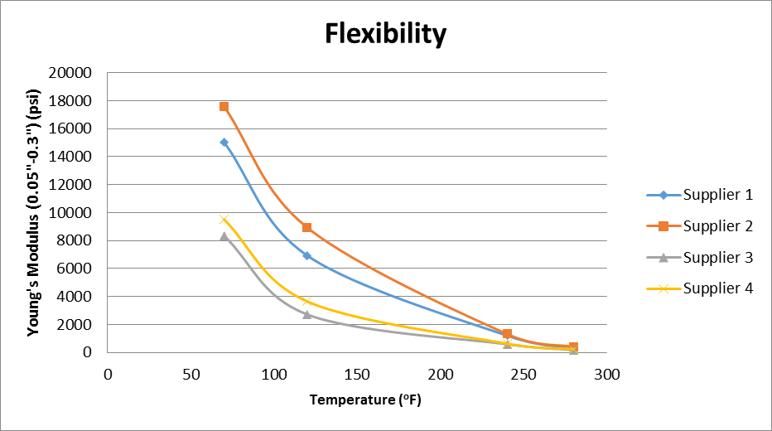
POTENTIAL DIFFERENCE
Between Aging at 240ºF/224 days and 275ºF/56 days
Young’s Modulus (Stiffness) of Unreinforced TPO Membrane Samples
Notes:
Previous studies have shown that typical roof top temperatures vary from below freezing to close to 200F under PV panels. Figure 2 shows that even at 240ºF, TPO loses about 90% of its stiffness. This would barely be considered a membrane since the polymer is so soft. At 280ºF, the membrane is about 50% softer again, and may even be starting to flow. If the membrane is so hot that it may start to flow at 280ºF , is this representing the degradation mechanisms seen in service, or is this a torture test?

Slide 28
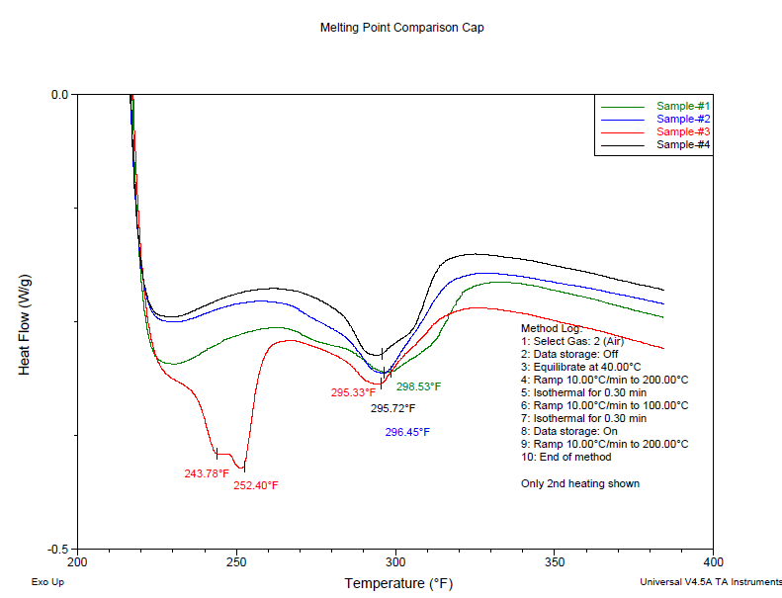
DSC CURVES FOR TPO CAP MATERIALS
Current ASTM
240ºF
275ºF

Slide 29
FLEXIBILITY CONCERNS
TPO membranes have already lost 90% of their polymer stiffness at 240ºF.
They will lose another 50% at 275ºF
Melting point of TPO formulations are around 295-298ºF.
Is the TPO Membrane really the same at 275ºF as it is at in-service temperatures?

Slide 30
STABILIZER CAPABILITIES
Long Term Thermal Stability
Melt Processing Stability
Hindered Amine
Hindered Phenol
Thiosynergist
Phosphite Hydoxylamines
0
100
200
300
400
500
600
Temperature (ºF)
Notes:
Figure shows the families of additives which are used, and their effective temperature ranges. The red line at 240ºF is the current ASTM aging temperature, and it can be seen that some of the additives start to lose efficacy at this temperature, and are even less effective at 275ºF. The significance is that current TPO membranes appear to perform well with regard to in-service temperatures. If they need to be tested at 275ºF, different additive packages may need to be used. For example, more hindered phenols may be required to pass the test at 275ºF. However, hindered phenols do not really work at in-service temperatures. The risk is that although the TPO may be formulated to pass the test, and work at very high temperatures, it may not work as well in-service. Again, this is the torture test analogy, and the law of unintended consequences.

Slide 31
STABILIZER CONCERNS
TPO Stabilizer packages are designed to perform at service temperatures
Some additives start to lose efficacy at higher temperatures
Formulating for higher testing temperatures may require the use of alternate thermal stabilizers, and we don’t know how well they work at service temperatures.

Slide 32
WELD STRENGTH AT 1150ºF

Slide 33
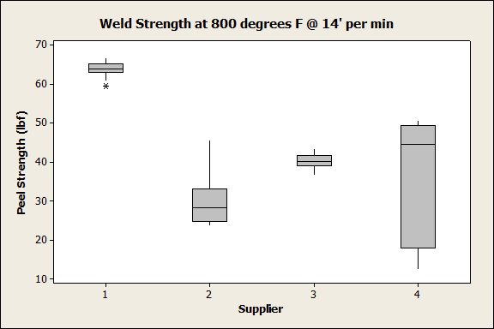
WELD STRENGTH AT 800ºF

Slide 34
WELD WINDOW FROM 800 ⁻ 1150ºF

Slide 35
INSTALLATION DIFFERENCES
Notes:
For TPO membranes one way to examine this requirement in performance is to look at a materials “weld window”. The weld window is defined not only by the strength of the weld, but by the material’s ability to be welded over a wide range of speeds and temperatures
Two test temperatures for the welder were evaluated, we looked at both 800F and 1150F keeping the speed constant at 14’ per min.
Peel testing was performed on the samples produced. The light blue bar represents the maximum peel tested at 800F and the dark blue bar represents the maximum peels tested at 1150F.
The red line represents days to failure at 275F
The concern that is illustrated here is the amount of weld variability that is observed in the TPO membranes that perform well in the accelerated aging test at 275F

Slide 36
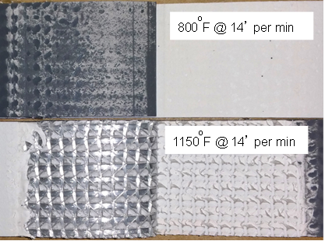
INSTALLATION CONCERNS
Membranes that perform well at the 275ºF accelerated test appear to show greater variability in low temperature weld strength
Cold welds were also observed in some of the samples tested.
Notes:
A wider weld window helps provide the contractor with the confidence that regardless of level of experience of the crew, the membrane can be welded in a variety of conditions.

Slide 37
RISK & BENEFITS
RISK
BENEFIT
TPO has lost 90% of its stiffness at test temp.
Stabilizers may need to be optimized for higher temps.
Weld variability is increased with high temperature TPOs
Shorter testing time
Lower testing costs

Slide 38
SUMMARY
Roofing membranes have all experienced early life failures
Product Standards have been modified and updated to address those early field failures
“Test of Time”
Changing Product Standards to address one aspect of product performance could result in unintended consequences.
Is the benefit of the change worth the risk?

Slide 39
TPO Weathering
By: Zebonie Sukle

